Slide 1


NBA Player Salaries
A Machine Learning Model
To Predict NBA Salaries
Dashboard: https://public.tableau.com/app/profile/dean.arnold/viz/NBASalariesDashboard/NBASalariesDashboard?publish=yes
Notes:
Hi everyone, my name is Syed and I will be presenting for group 12. Our project involved creating a machine learning model to predict the salaries of NBA players based on performance statistics. I’ll elaborate on this shortly.

Slide 2
Table of Contents
Page 3 - Introduction
Page 4 - Hypothesis
Page 5 – Source of Data
Page 9 - Brief Summary of CPI (Consumer Price Index)
Page 10 - Data Exploration/Analysis
Page 14 – Machine Learning Models
Page 15 – Results
Page 19 Future Considerations
Notes:
This is just a brief table of contents for our presentation (go over the contents)

Slide 3
Introduction
Basketball is a rapidly growing sport internationally. The National Basketball Association(NBA) is the league where the top paid and most valuable players play. It was founded in New York City on June 6, 1946, and is currently the third wealthiest professional sports league in North America. Since 2020, the NBA has the highest average annual salary of all professional associations in the world.
As a group we have a mix of interest in sports and finance. In order to accommodate and combine the interests, we decided to investigate the finance side (i.e. salaries) of sports.
We used machine learning models to analyze the statistical production of each player and determine what their salary range will be.
“Everything is worth what its purchaser will pay for it” — Publilius Syrus
Notes:
As I’m sure you’re all ware, basketball is a popular and rapidly growing sport, and boasts some of the highest player salaries of any sports league in the world. Our team wanted to explore datasets pertaining to sports but also had and strong interest in finance, so we decided that investigating the financial aspects of sports was the best course to take. More specifically, we wanted to look at how player performance statistics impacts salary, and wanted to create a machine learning model to predict salary based on stats.

Slide 4
Hypothesis
The statistics mentioned before will be consider the ‘features’ of our Machine Learning Model. The salary will be the ‘output’. The question we will be hoping to answer is: “Can we predict a player’s salary based on their NBA statistics?”
Notes:
Our hypothesis/question we wanted to answer was: given a dataset of NBA player performance statistics, can we accurately predict player salary?

Slide 5
Source of Data
Our datasets currently contain data on NBA players and their season stats. It also contains biographical information and the records of their teams.
-https://www.kaggle.com/whitefero/nba-player-salary-19902017
-https://www.kaggle.com/drgilermo/nba-players-stats
-https://data.world/gmoney/nba-team-records-by-year
Notes:
Onto our data sources. These are links to our datasets, they include data on player salary and stats, as well as team records data

Slide 6
Source of Data
We are looking to answer how much a player should be paid with the amount of on court statistical production they provide in the major categories. Points, rebounds, assists, steals, blocks, three pointers made, field goal percentage, three point percentage, team record and turnovers are all considered.
The datasets that we found provide salary from the 1990-2017 seasons, which is when the league’s players experienced a massive increase to their salary from the new Collective Bargaining Agreement in 2017.
Notes:
To give you a better idea of the data we worked with, here are some of the stats we were looking into: Points, rebounds, assists, steals, blocks, three pointers made, field goal percentage, three point percentage, team record and turnovers. We also focused on a particular time period: 1990-2017. Our datasets only had salary info from 1990 onwards, and in 2017 there was a major increase in salary due to a new Collective Bargaining Agreement.

Slide 7
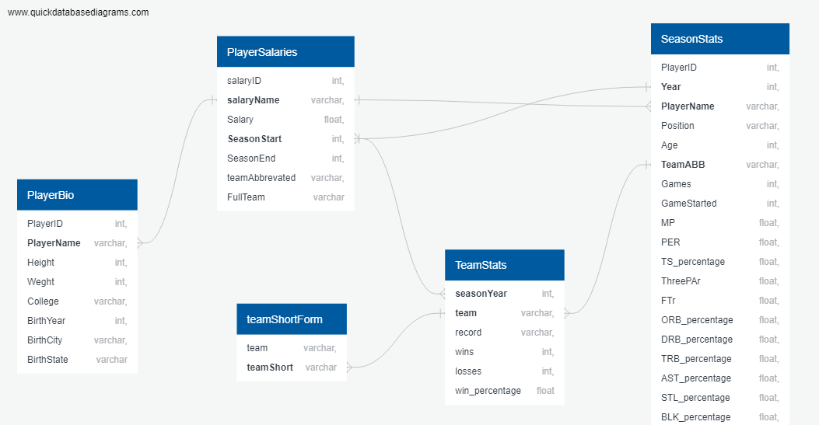
Source of Data
Our datasets currently contain data on NBA players and their season stats. It also contains biographical information and the records of their teams.
https://www.kaggle.com/whitefero/nba-player-salary-19902017
https://www.kaggle.com/drgilermo/nba-players-stats
https://data.world/gmoney/nba-team-records-by-year
Notes:
This is our entity relationship diagram, showing some of the tables we created. As you can see, we had table for player biographical info, salaries, team stats, and season stats (this held most of the raw data on player stats). There was also a table created for abbreviated team names, I’ll go into more detail on that shortly

Slide 8
Source of Data
Key Variables to be used in joining tables (identifying primary/foreign keys) :
Player Names
Year (season start year)
Team Names
Notes:
Based on our entity relationship diagram, we determined the three key variables for joining our tables and creating our final dataset: player name, team name, and year which is the season starting year

Slide 9
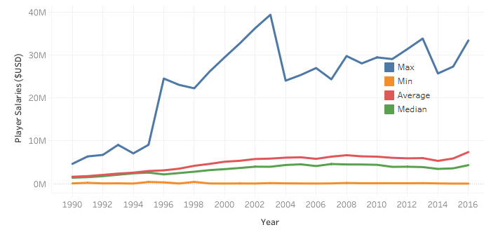
Brief Summary of CPI (Consumer Price Index)
Definition:
A statistical estimate of price fluctuations based on a weighted average of prices for a list of consumer goods and services
Relies on historical price data collected periodically
Can be used to estimate inflationary price increases
Purpose for our project:
Source data included player salaries over several years
For salary summaries (sum, average, etc.) for players to be comparable, we required the salaries to be adjusted so that each year represented the same $ value
CPI module was checked for accuracy and then applied to our source data
Notes:
Before we move forward, I just want to provide a brief summary of a module we used in our code. It’s a CPI module (consumer price index). CPI is a metric used to estimate prince increase due to inflation. The reason this is important for our project is that we had salary data over several years, and the $ value of course varied for each year. To compare salaries, we decided to implement a CPI module so that the salary data was standardized to the same $ value. This graph shows min, max, average, and median player salary over time once adjusted for inflation.

Slide 10
Data Exploration/Analysis Tools Used
Excel was used for ease to explore/filter through whole dataset
SQL was used to join raw csv/datasets into one table
Python/Pandas was used to load in and clean data
Python/Pandas was also used for Machine Learning
Notes:
Next, I want to go over some of the tools we used. Our raw data was .csv, and we used excel to filter and explore data, SQL to create tables, and Python (with Pandas) for preprocessing, analysis, and the machine learning models.

Slide 11
Data Exploration/Analysis Database
The following describes the SQL tables that were created:
Player Salaries (from raw data)
Player Bio (from raw data)
Season Stats (from raw data)
Team Stats (new table)
Team name short form (new table)
Raw data included the team names variable in both abbreviated and full name form – a new table was created matching each full name to it’s abbreviation in order to join raw data tables
Notes:
So, a brief recap of our tables – player, salaries, biographics, season stats, team stats, and a team name short form table. Our raw data had full and abbreviated team names, so we created a new table with full names and abbreviations for joining our tables

Slide 12
Data Exploration/Analysis Final Joined Table
Team stats was joined with the Team name short form table to create an updated team stats table (joined on team name)
Season stats was joined with player salaries to create a combined season/salary table (joined on player name and year as each player is paid annually)
The above two tables were joined on team name and year – this orders the table based on player team record for each year
The final table was exported as a csv and loaded into a pandas dataframe for cleaning and analysis
Notes:
Here is a detailed explanation for our final joined table. We created a table from joined team stats and abbreviated team names, and another table joined from season stats and salary. We joined the above two on ‘year’ and ‘name’ for proper order, and exported as a csv and loaded it into a Pandas dataframe for cleaning and analysis.

Slide 13
Data Exploration/Analysis Data Cleaning
The table was filtered to remove all non-predictive variables
Salary data was unavailable before 1990, so values for all prior years were dropped
Players can play for more than one team per year. For analysis, we required certain values be summed (player stats, as these will vary for each team per year) and others averaged (salaries, as these are annually reported and the same across teams
We ran into issues when trying to sum or average individual columns (all columns ended being summed or average), to overcome this we created separate tables containing sums and averages and merged them on a common id (player name and year)
Unnecessary variables were dropped, and the CPI module was applied to create the cleaned dataframe
Notes:
Some details on our cleaning procedure: we dropped all non-predictive and unnecessary variables, dropped data before 1990 (as salary data was only available starting 1990), and applied and finally applied our CPI module was inflation-adjusted salaries. We did run into an issue during data cleaning (describe issue with summing and averaging)

Slide 14
Machine Learning Models
Linear Regression: Used to determine if we could predict salary based on aggregate stats by curve-fitting
Random Forest: Used to determine if stats can predict salaries divided by clusters (based on various ranges) and rank the feature importance of stats
Notes:
Onto our machine learning models. We actually used to models (the reason for this will be clear soon) – linear regression to predict salary based on aggregate stats, and random forest to determine if we could predict salaries in specific ranges and to identify the most important features

Slide 15
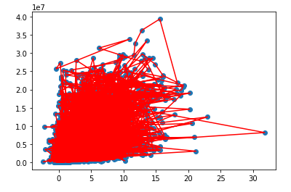
Results
Linear Regression Model
Plot shows adjusted salary vs aggregate stats
Linear Regression model unable to generate predictive line of best fit
Let’s try another ML model
Notes:
Here the results of the linear regression model. As you can see our output was a little chaotic. The graph shows adjusted salary vs aggregate stats. Clearly, regression was not able to generate a best-fit line – the aggregate data is simply too scattered and there are no identifiable trends. We decided to try another model.

Slide 16
Results
Random Forest Model – Binning by salary range
Bins Sizes: starting at $1 million, then increasing bin sizes to $2, 5, and $15 million
Upper salary limit: $40 million
9 bins in total
Model was used to determine predictiveness of stats by categorical salary range, and overall accuracy
Notes:
For our random forest model, we created salary clusters. Bins were created for salaries ranging from $0 to $40 million. We had 9 bins in total, and the bin sizes increased from $1m to $2m, $5m, and $15m, to keep our bin sizes relatively equal and to have a manageable number of bins.

Slide 17
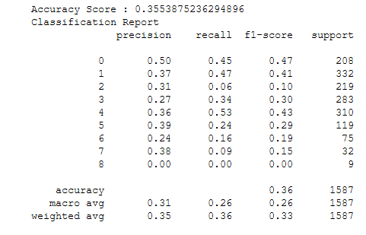
Results
Random Forest Model - Classification Report
Rows are each of the bins
Precision ranges from 0 to 0.50
Recall ranges from 0 to 0.53
The model is susceptible to both false positives and false negatives (low precision and recall scores for all ranges)
Low accuracy score of 36%
The model could not predict true positives for the highest salary range (annual salaries above $25M)
Notes:
This is part of the results of our model, the classification report. The indices on the left are the various bins, and we have data for precision, recall, combined f1 score, for each bin (describe results).

Slide 18
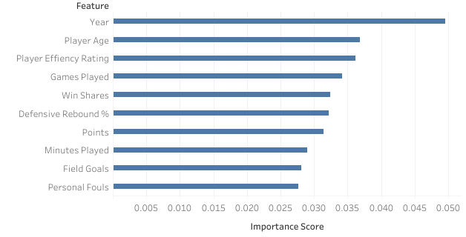
Results
Random Forest Model – Feature Importance
Top 10 Features by Importance:
The most important feature was the year, sharply above player stats
As expected, player age is highly predictive of salary, as performance can drop as players age
Player stats are relatively close in importance score
Notes:
Here are our top 10 features (describe results)
*** present dashboard

Slide 19
Future Considerations
The machine learning models demonstrated limited success in predicting our target feature.
This indicates that there are key factors besides player stats, not included in the raw dataset, that strongly influence salary. Some factors might be:
Features of the Collective Bargaining Agreement such as salary cap, maximum/minimum contracts and rookie contracts
Perceived player value based on specific skills not reflected in stats
Injuries resulting in dropped production, whilst the player is still being paid
Voluntary salary cuts that players might take when signing with a team that is perceived to have a high chance of winning championship
Less desirable teams overpaying to retain players
Notes:
Our model was not entirely successful at predicting salaries based on stats. There are clearly other factors that are important when it comes to player salaries, such as aspects of the collective bargaining agreement, perceived player value that stats don’t reflect, injuries resulting in low production, voluntary salary cuts, certain teams overpaying.

